Slide 1
Computational Complexity
Algorithmics vs. Complexity
  Algorithmics
    Given a problem, we can prove that the problem can be solved in a time of O(f(n)) by giving and analyzing an algorithm
    We’d like to reduce f(n) as much as possible
  Complexity
    It tells us any algorithm capable of solving our problem correctly takes a time (g(n))
    Now g(n) is a lower bound on the complexity of the problem
    If f(n)  Θ(g(n)), we’re satisfied

Slide 2
Topics
Arguing a lower bound
  Information-theoretic arguments
  Adversary arguments
Proof equivalence of complexity or compare complexity
  Linear reductions
  NP-completeness

Slide 3
Information-theoretic arguments
Particularly applies to those problem involving comparisons
Uses a decision tree to represent the working process of an algorithm on all possible data of a given size
  A decision tree is a binary tree where
    Each internal node contains a test on the data
    Each leaf contains an output, called verdict
    A trip through the tree starts from the root and recursively goes to the left subtree or the right subtree depending on whether the answer to the root is “yes” or “no”
    The trip ends when it reaches a leaf (verdict)

Slide 4
A decision tree for sorting
A<B
Y
N
B<C
B<C
N
Y
N
Y
A<B<C
A<C
A<C
C≤B≤A
Y
N
Y
N
A<C≤B
C≤A<B
B≤A<C
B<C≤A
Note that the number of leaves = The number of possible outputs

Slide 5
Insertion Sort
void insertionSort(int A[], int n)
{ // array index starts from 1 here
int i, j, x;
for (i=2; i<=n; i++) {
x =A[i];
j = i-1;
while (j>0 && x<A[j]) {
A[j+1] = A[j];
j--;
}
A[j+1] = x;
}
}

Slide 6
A three-item insertion sort decision tree
B<A
Y
N
ABC
BAC
C<A
C<B
Y
Y
N
BAA, x=C
ABB, x=C
N
C<B
BAC
C<A
ABC
Y
N
Y
N
CBA
BCA
CAB
ACB
C<B<A
B≤C<A
B<A≤C
C<A≤B
A≤C<B
A≤B≤C

Slide 7
Observations
The number possible outputs = The number of leaves (verdicts)
The worst-case time is the height of the tree
The average time is the average depth of leaves assuming equal distribution

Slide 8
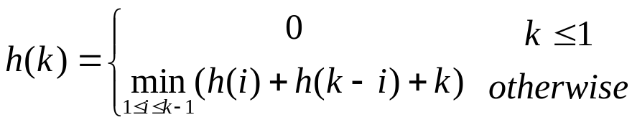
Theorem
Any binary tree with k leaves has an average height of at least lg k
  Let h(k) be smallest possible total depths for a tree of k leaves
Any comparison-based algorithm takes a worst case time and average case time (n log n)

Slide 9
Adversary arguments
Start the algorithm on an input that is initially unspecified except for its size
When the algorithm probes the input, the malevolent daemon, the adversary, answers in a way that will force the algorithm to work hard
  The daemon’s goal is to keep the algorithm uncertain of the correct answer as long as possible
  Constraint: the daemon’s answers must be consistent—there always exists at least one input that could cause the algorithm to see exactly the same answers on its probes

Slide 10

Finding the maximum of an array
A simple algorithm takes a time of Θ(n)
Using decision tree, we get
  Any comparison based algorithm to find the maximum must perform at least comparisons in worst case
Can we find a tighter lower bound?
  We use adversary arguments to show n-1 comparisons are necessary

Slide 11
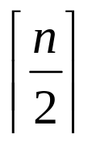
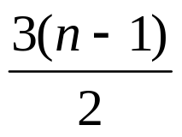
Find the median
For a comparison-based algorithm, we can easily argue a lower bound of comparisons
Can we find a tighter bound?
  We can prove a lower bound of comparisons

Slide 12
Adversary arguments
Assume n is odd and n  3.
Initially, the daemon sets each entry to “uninitialized”
  As the algorithm makes comparisons, the daemon set values between 1 and n (low) or between 3n+1 to 4n (high).
  The daemon makes sure #low items = #high items

Slide 13
Comparison
When T[i] is asked to compare to T[j]
  T[i] and T[j] are both unintialized
    T[i] is sets to i and T[j] is set to 3n+j.
  One is uninitialized
    If it is the only one uninitialized item left, set its value to 2n which becomes provisional median.
    If T[i] is low, set T[j] to high value 3n+j. And add one uninitialized item T[k] to low, i.e., set T[k] to k.
    If T[j] is low, set T[i] to high value 3n+i. And add one uninitialized item T[k] to low, i.e., set T[k] to k.
    If T[i] is high, set T[j] to low value j. And add one uninitialized item T[k] to high, i.e., set T[k] to 3n+k.
    If T[j] is high, set T[i] to low value i. And add one uninitialized item T[k] to high, i.e., set T[k] to 3n+k.
  Both are initialized

Slide 14
Arguments
Both are initialized
  If both are low or one low and one provisional median, then the smaller has lost a comparison
  If both are high or one high and one provisional median, then the larger has lost a comparison
  Otherwise, no one lost comparison
Arguments: if less than 3(n-1)/2 comparisons
  (n-1)/2 comparisons needed to initialize all values
  Less than n-1 comparisons for initialized values
    Less than n-1 values lost comparisons
    At least one item in addition to the provisional median never lost a comparison

